Slide 1

Trigonometric Integrals
Copyright © Cengage Learning. All rights reserved.

Slide 2
Objectives
Solve trigonometric integrals involving powers of sine and cosine.
Solve trigonometric integrals involving powers of secant and tangent.
Solve trigonometric integrals involving sine-cosine products with different angles.

Slide 3
Integrals Involving Powers of Sine and Cosine

Slide 4
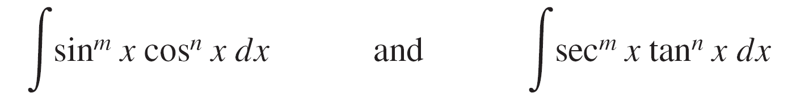
Integrals Involving Powers of Sine and Cosine
In this section you will study techniques for evaluating integrals of the form
where either m or n is a positive integer.
To find antiderivatives for these forms, try to break them into combinations of trigonometric integrals to which you can apply the Power Rule.

Slide 5
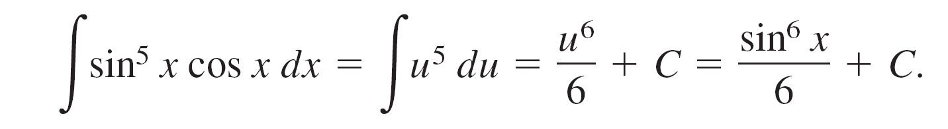
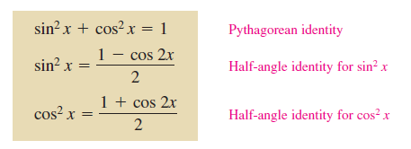
Integrals Involving Powers of Sine and Cosine
For instance, you can evaluate ∫ sin⁵ x cos x dx with the Power Rule by letting u = sin x. Then, du = cos x dx and you have
To break up ∫ sin^{m} x cos^{n} x dx into forms to which you can apply the Power Rule, use the following identities.

Slide 6
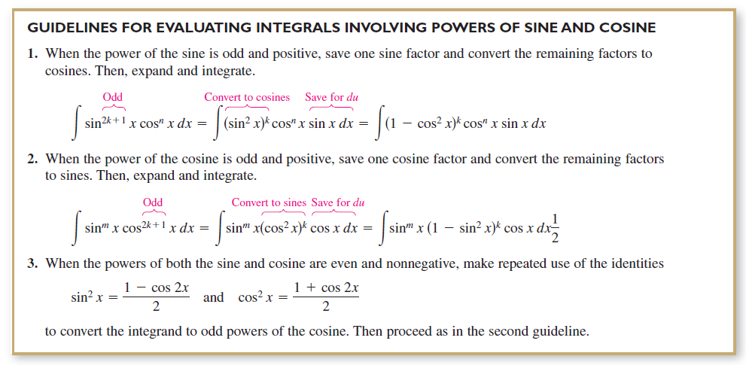
Integrals Involving Powers of Sine and Cosine

Slide 7
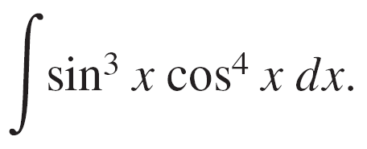
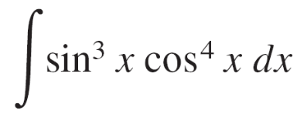
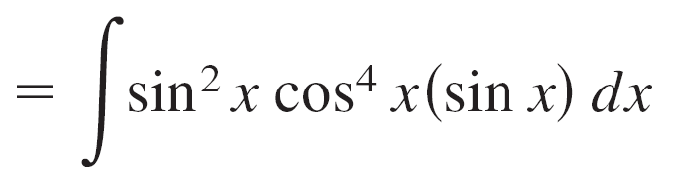

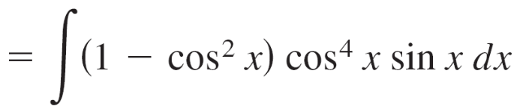

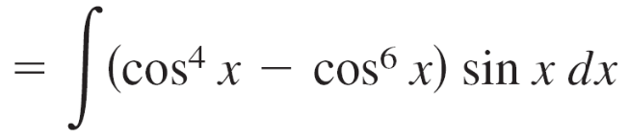

Example 1 – Power of Sine Is Odd and Positive
Find
Solution:
Because you expect to use the Power Rule with u = cos x, save one sine factor to form du and convert the remaining sine factors to cosines.

Slide 8
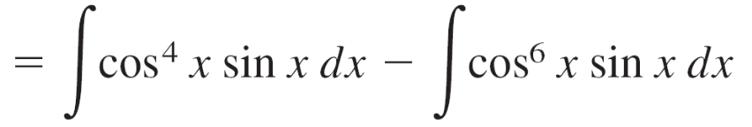

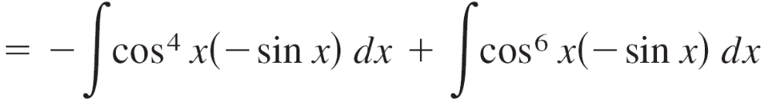
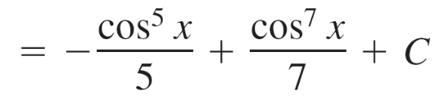

Example 1 – Solution
cont’d

Slide 9
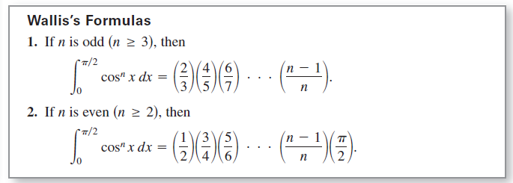
Integrals Involving Powers of Sine and Cosine
These formulas are also valid if cos^{n} x is replaced by sin^{n} x.

Slide 10
Integrals Involving Powers of Secant and Tangent

Slide 11

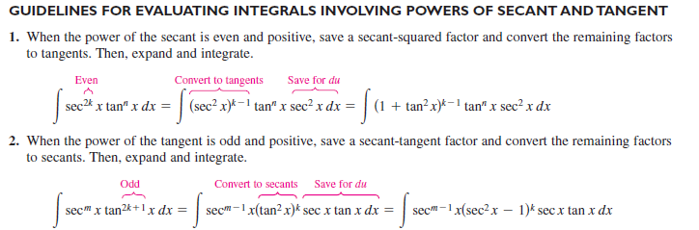
Integrals Involving Powers of Secant and Tangent
The following guidelines can help you evaluate integrals of the form

Slide 12
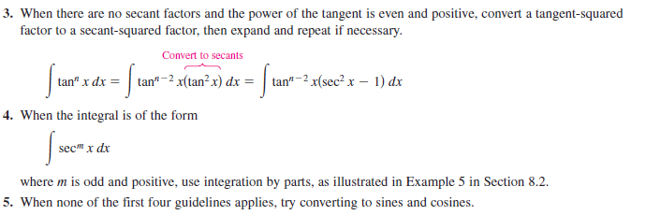
Integrals Involving Powers of Secant and Tangent
cont’d

Slide 13
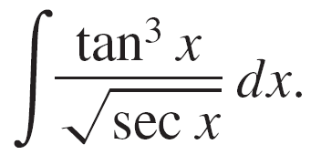
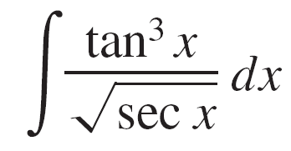
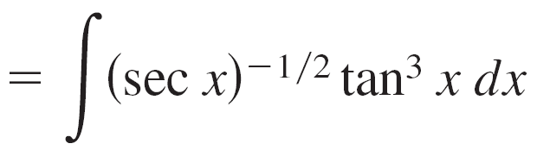
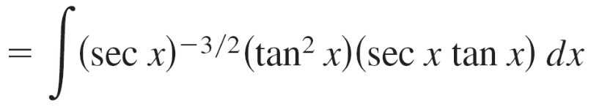
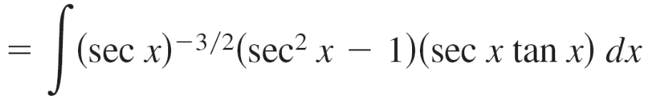
Example 4 – Power of Tangent Is Odd and Positive
Find
Solution:
Because you expect to use the Power Rule with u = sec x, save a factor of (sec x tan x) to form du and convert the remaining tangent factors to secants.

Slide 14
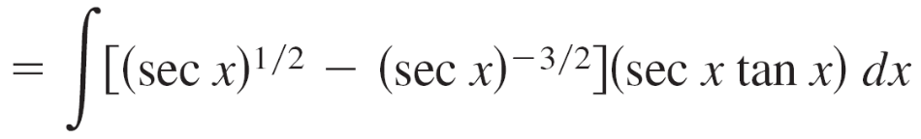
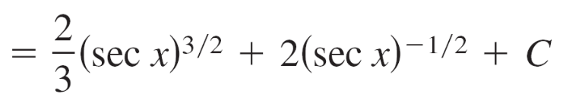
Example 4 – Solution
cont’d

Slide 15
Integrals Involving Sine-Cosine Products with Different Angles

Slide 16
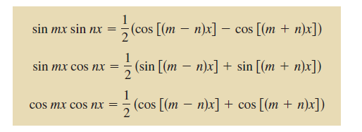
Integrals Involving Sine-Cosine Products with Different Angles
Integrals involving the products of sines and cosines of two different angles occur in many applications.
In such instances, you can use the following product-to-sum identities.

Slide 17
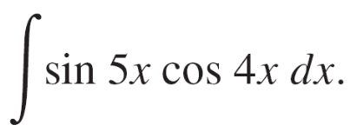
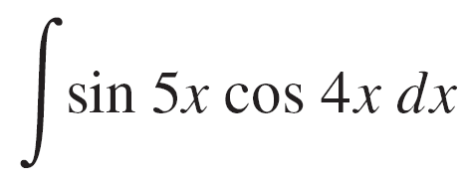
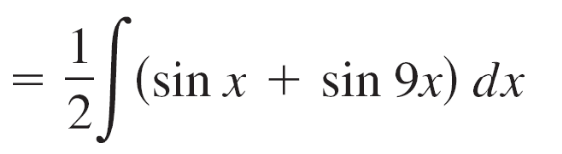
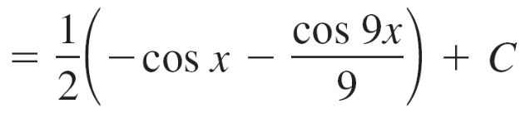
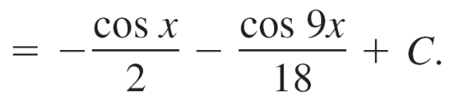
Example 8 – Using Product-to-Sum Identities
Find
Solution:
Considering the second product-to-sum identity above, you can write

